Slide 1
Dynamic Weather Dashboard
CAPSTONE PROJECT
Presented By:
1. Kirve Vaishnavi Ganesh-VPKBIET-AIDS

Slide 2
OUTLINE
Problem Statement
System Development Approach
Algorithm & Deployment (Step by Step Procedure)
Result
Conclusion
Future Scope
References

Slide 3
Problem Statement
Users need real-time, location-based weather information in a simple interface.
This dashboard fetches and displays weather data like temperature, conditions, and forecasts.
It enhances user convenience and supports better travel planning.

Slide 4
System Approach
Frontend Technologies:
HTML5 – Provides the structural layout of the webpage.
CSS3 – Enables styling and responsive layouts for various screen sizes.
JavaScript – Adds dynamic interactivity such as cart management, product filtering, and total price calculations.
Bootstrap – Offers pre-built responsive components and a grid system to speed up development and ensure
consistency across devices.
Design Approach:
Clean and user-friendly interface to enhance user experience.
Mobile-responsive design ensures compatibility across all screen sizes and devices.
Use of Bootstrap components for quicker layout building and consistent UI elements.
Modular separation of HTML, CSS, JS, and Bootstrap files for better maintainability and scalability.

Slide 5
Algorithm & Deployment
Weather Data Integration:
Fetch real-time weather data based on user’s location using a public weather API (e.g., OpenWeatherMap).
Display key weather details such as temperature, weather condition, humidity, wind speed, and forecast.
Frontend Design:
Layout built using HTML and CSS, incorporating clean UI elements and card-based design for weather info.
Use responsive grid systems for organizing current weather and forecast data clearly.
Interactive Features:
Auto-detect user location using Geolocation API for localized weather updates.
Search functionality to manually check weather in different cities.
Dynamic weather icons and background changes based on current weather condition (e.g., rain, sun, snow).
Toggle between temperature units (°C/°F).
Hourly and 5-day forecast views with expandable detail modals.
Testing:
Ensure cross-browser compatibility for consistent performance across major web browsers.
Verify mobile responsiveness for seamless usage on smartphones and tablets.
Deployment:
Host using GitHub Pages or Netlify for free and easy public access.
Ensure proper API integration and error handling (e.g., when location or city not found)

Slide 6
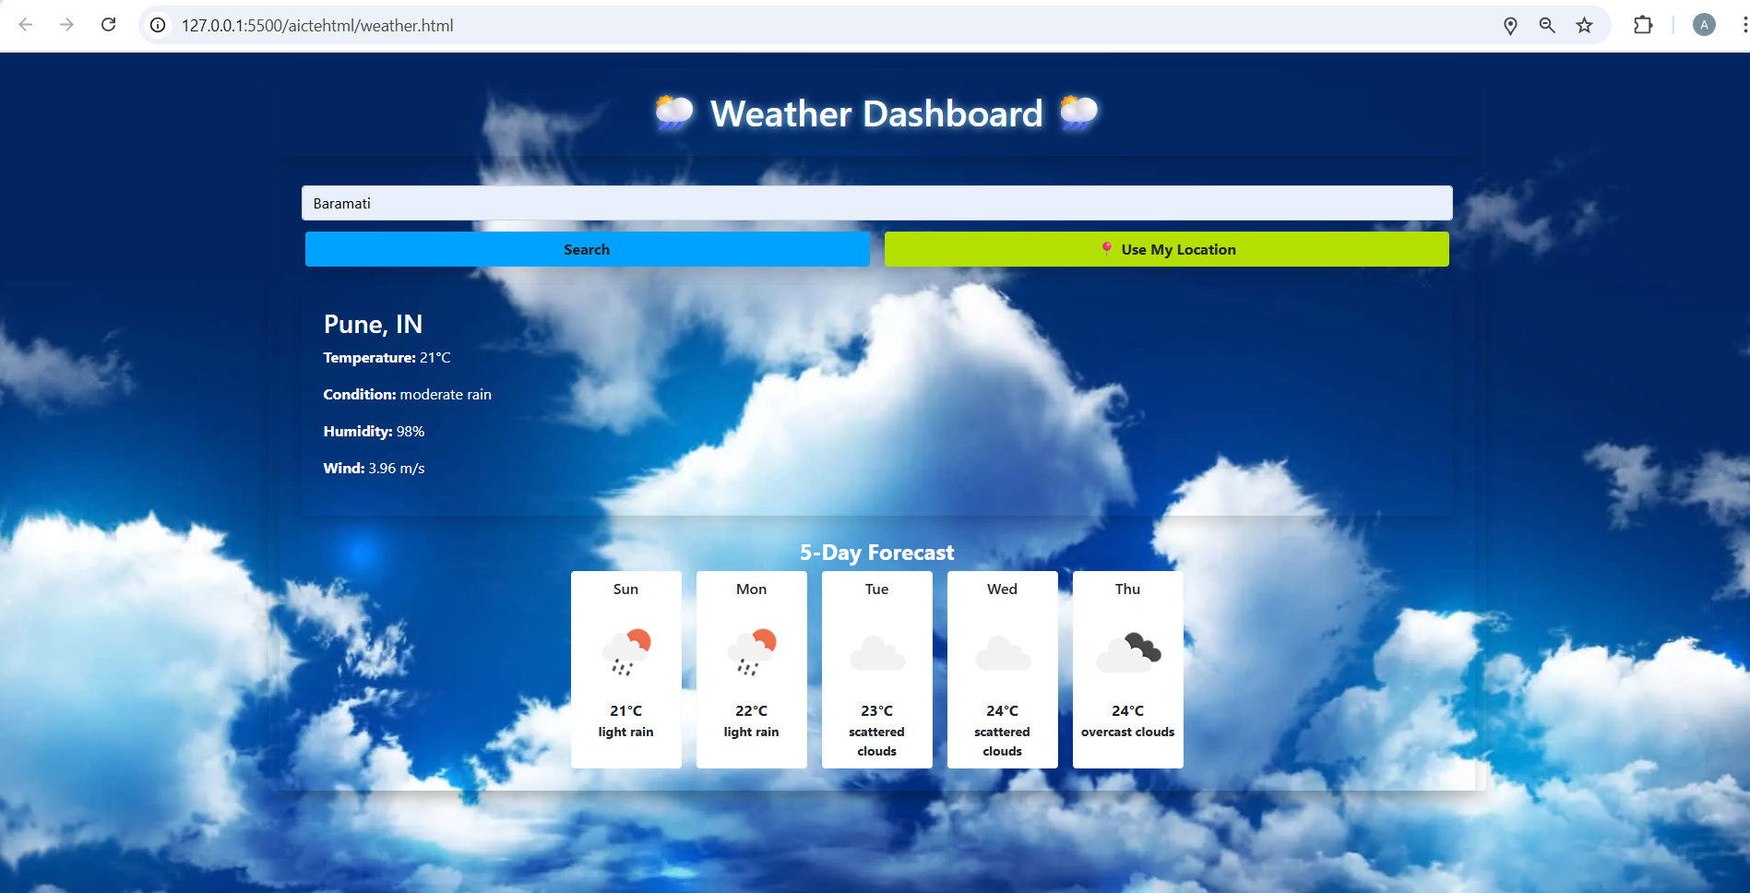
Result
Github Link :-https://github.com/Vaishu1976/AICTE-task

Slide 7
Conclusion
This project delivers a cost-effective and user-friendly online platform tailored for small businesses, removing the need for complex and expensive e-commerce solutions. It offers customers an engaging and seamless shopping experience through an intuitive product gallery. Additionally, the real-time, location-based weather dashboard provides users with accurate and easy-to-understand weather updates, enhancing convenience and helping with daily planning. Together, these tools empower both businesses and users with simplicity, efficiency, and interactivity.

Slide 8
Future scope(Optional)
Weather Alerts: Show real-time warnings for storms, heatwaves, etc.
Weather Maps: Add interactive maps and radar for better visuals.
Air Quality Info: Include AQI, UV index, and pollen data.
Multi-language Support: Make the app usable in different languages.
Customization: Let users choose themes, units (°C/°F), and save locations.
Offline Mode: Show last saved weather data without internet.
Mobile App: Build a mobile version with push notifications.

Slide 9
References
OpenWeatherMap API – For real-time weather data and forecasts. 🔗 https://openweathermap.org/api
Bootstrap Documentation – For responsive UI components and grid system. 🔗 https://getbootstrap.com
Geolocation API (HTML5) – To detect user’s location for weather updates. 🔗 https://developer.mozilla.org/en-US/docs/Web/API/Geolocation_API

Slide 10
THANK YOU

